Slide 1


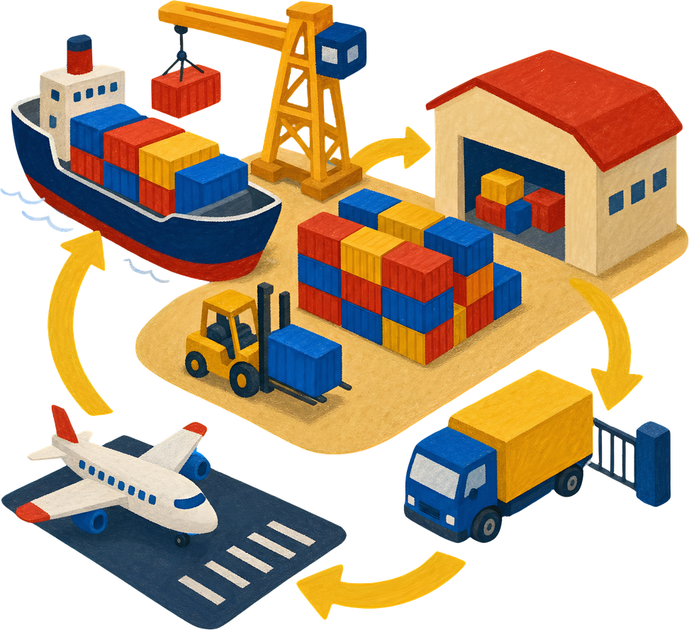
Supply Chain
Visibility &
Optimisation
Milestone 1: Data Preprocessing
Dataset: Brazilian E-Commerce / Olist merged dataset
Team 4: Mahi · Vishal · Ramya · Abdul Haseeb
Page:01
Notes:
1

Slide 2

About The Dataset
The Brazilian E-Commerce Public Dataset by Olist is a real-world e-commerce dataset containing information on approximately 100,000 customer orders placed between 2016 and 2018 across multiple online marketplaces in Brazil. It includes comprehensive data related to customers, sellers, products, payments, deliveries, and customer reviews, enabling end-to-end analysis of the order lifecycle.
Page:02
Notes:
1

Slide 3

Dataset Overview
Merged e-commerce supply-chain data prepared for visibility, delivery and freight analysis.
119,143
40
0
66,039
Raw Records
Raw Columns
Duplicates
Cleaned Output
initial rows
features
exact rows
rows after IQR
Important data areas in the dataset
Orders
Customers
Sellers
status, purchase, approval, delivery dates
city and state information
seller IDs, city and state
Products
Payments
Reviews
category, dimensions and weight
type, installments and value
score, creation and answer time
Milestone 1 focuses only on preparing the dataset: checking quality, cleaning missing values, validating columns and saving the cleaned file.
Milestone 1
Page:03
Notes:
2

Slide 4
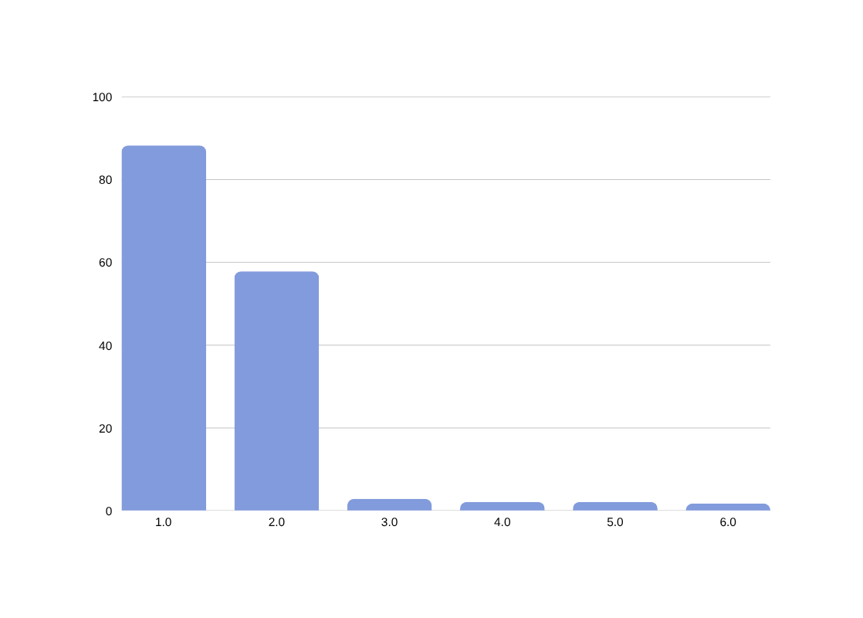

Initial Data Quality Check
The raw dataset was inspected using shape, info, duplicates and missing-value analysis.
Key Checks Performed
Viewed first and last records
Checked row/column count
Checked data types with info()
Checked exact duplicate rows
Calculated missing-value counts and percentages
No exact duplicate rows found
Observation: Review text fields had very high missing values, so they were removed. Delivery-date missing values were kept meaningful for order-status analysis.
Milestone 1
Page:04
Notes:
3

Slide 5

Cleaning Actions Performed
The notebook cleaned the dataset in a simple and structured order.
01
02
03
Removed unnecessary columns
Filled missing categories
Filled numerical fields
Dropped review comments, customer_unique_id and zip-code prefix columns to reduce noise.
Product categories were replaced with “Unknown” instead of deleting those orders.
Product weight, length, height, width and product details were filled using median values.
04
05
06
Completed seller & payment fields
Fixed approval dates
Removed broken key records
Seller/payment missing values were filled using mode or median based on column type.
Missing approval dates were filled using purchase timestamp when approval time was unavailable.
Rows without order_item_id or product_id were removed because they cannot be used for item-level analysis.
Milestone 1
Page:05
Notes:
4

Slide 6

Date Columns & Delivery Feature
Delivery dates are central to supply-chain visibility and delay analysis.
1
2
3
4
5
Purchase
Approved
Carrier
Delivered
Estimated
order_purchase_timestamp
order_approved_at
order_delivered_carrier_date
order_delivered_customer_date
order_estimated_delivery_date
Created delay feature
Meaningful remaining nulls
delivery_delay = delivered_customer_date − estimated_delivery_date
Some delivery and review dates remain empty because cancelled, unavailable or undelivered orders do not have final delivery records.
Milestone 1
Page:06
Notes:
5

Slide 7
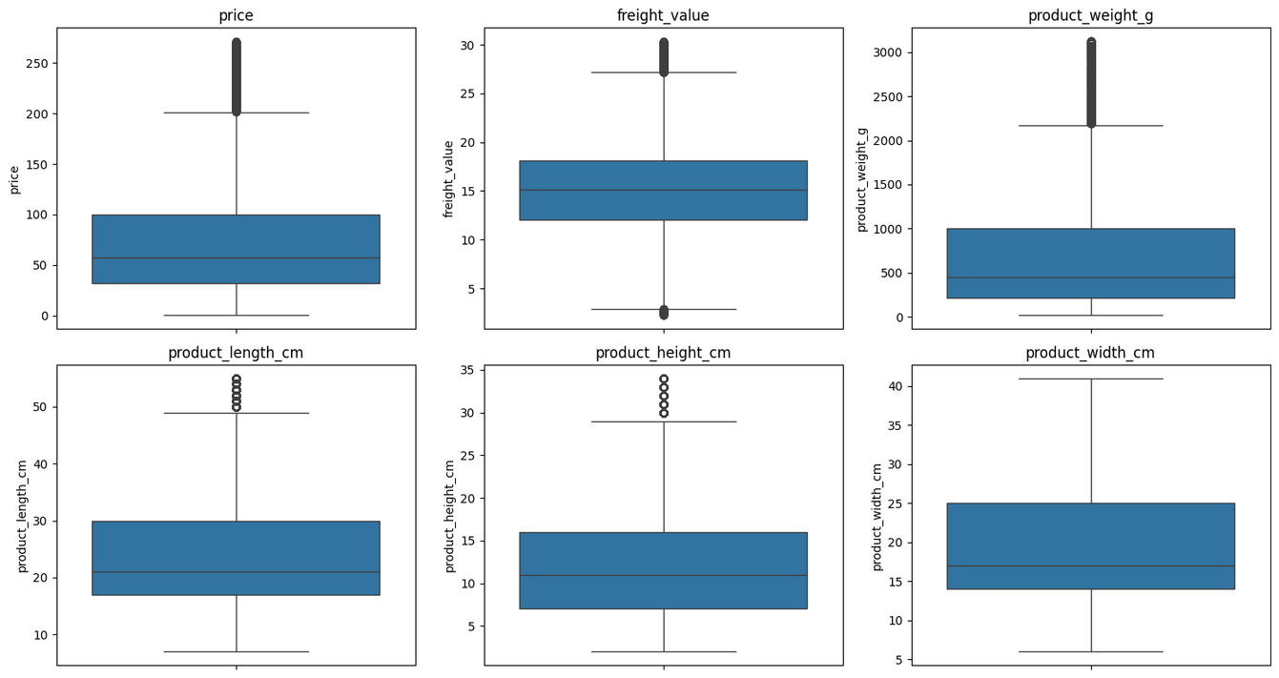
Outlier Detection & Treatment
Boxplots and IQR were used to detect extreme values in price, freight and product dimensions.
Column
Outliers
price
2,456
freight_value
1,528
product_weight_g
3,602
product_length_cm
2,877
product_height_cm
2,824
product_width_cm
0
Note: IQR filtering reduces extreme values and makes basic visualisation easier. For future ML, outliers can also be capped instead of removed.
81,170
66,039
before IQR filtering
after IQR filtering
Milestone 1
Page:07
Notes:
6

Slide 8
Final Validation & Output
The cleaned dataset is saved and ready for Milestone 2 Exploratory Data Analysis.
Check
Raw Dataset
After Preprocessing
Ready for EDA
Rows
119,143
66,039
Milestone 2 can now use clean columns for analysis.
Columns
40
36
Exact duplicate rows
0
0
Price ≤ 0
0
0
Next analysis areas
Freight value < 0
0
0
Order-status distribution
Top product categories
Freight vs price
Payment distribution
Seller-state analysis
Delivery delay vs review score
Product weight ≤ 0
0
0
Output file
—
Supply_Chain_Cleaned_Dataset.csv
Final statement: Milestone 1 successfully converted the raw merged dataset into a cleaned and analysis-ready supply-chain dataset.
Milestone 1
Page:08
Notes:
7

Slide 9
Thank You!
Milestone 1 Completed
Cleaned dataset prepared for EDA, visualisation and dashboard work.
Milestone 1
Page:09
Notes:
8

